Slide 1
NHTCA 2023 Fall Conference Record Retention
What to do and when to do it.

Slide 2
History
1660’s -1967
Keep all records!!!
1967–1974
44 record types in Statute
1977–2005
105 record types in administrative rules of MRB
2005 – present
163 record types back into Statute; MRB advisory.
Notes:
MRB = Municipal Revenue Bureau?

Slide 3
Purpose
To ensure records be retained that are required by law and essential to business.
To ensure outdated or unnecessary documents be destroyed in a systematic and thoughtful way.
To minimize the risk of public records falling victim to bad intentions.

Slide 4
State Laws
RSA 5:29
RSA 5:47
RSA 5:48
RSA 5:49
RSA 5:50
RSA 5:51
RSA 33-A:1

Slide 5
RSA 5:29 What is a record?
“…Any document, book, paper, manuscript, drawing, photograph, map, sound recording, video recording, electronic record, microform or other material, regardless of physical form or characteristics, made or received pursuant to law or in connection with the transaction of official business.”

Slide 6
RSA 5:47 – RSA 5:51 Local Government Records Management Program
Funds available for “cities, towns, or unincorporated places to preserve records.”
Applications approved by the “Grants Review Committee” made up of: two members of the municipal records board, NHTCA president, NHCTCA president, and One Town Clerk/Tax Collector.
State archivist, with the Municipal Records Grants Review Committee, awards the grants for records management for local governments.

Slide 7
RSA33-A:4-a Municipal Records Board
Director of the Division of Archives and Records Management
Director of NH Historical Society
State Librarian
Presidents of NHTCA, NHCTCA & ANHA
Registrar of Vital Records
Secretary of State
Municipal Treasurer or Finance Director – appointed by NHMA
Professional Historian - appointed by Governor
Representative of the Association of NH Historical Societies
Representative of the New Hampshire DRA
State Records Manager
Notes:
NH Association of assessing officials – possible change in name

Slide 8
RSA33-A:4-a & b Municipal Records Board Powers
Oversees the local government records management improvement program
Advises the Secretary of State on effective and efficient management of municipal records through:
Standards
Procedures

Slide 9
RSA 33-A-1 Definition of Municipal Records
““Municipal Records” means all municipal records, reports, minutes, tax records, ledgers, journals, checks, bills, receipts, warrants, payrolls, deeds and any other written or computerized material that may be designated by the board.”
Notes:
The NH Municipal Records Board – created(1977) for the purpose of creating rules to update the list of disposable records.

Slide 10
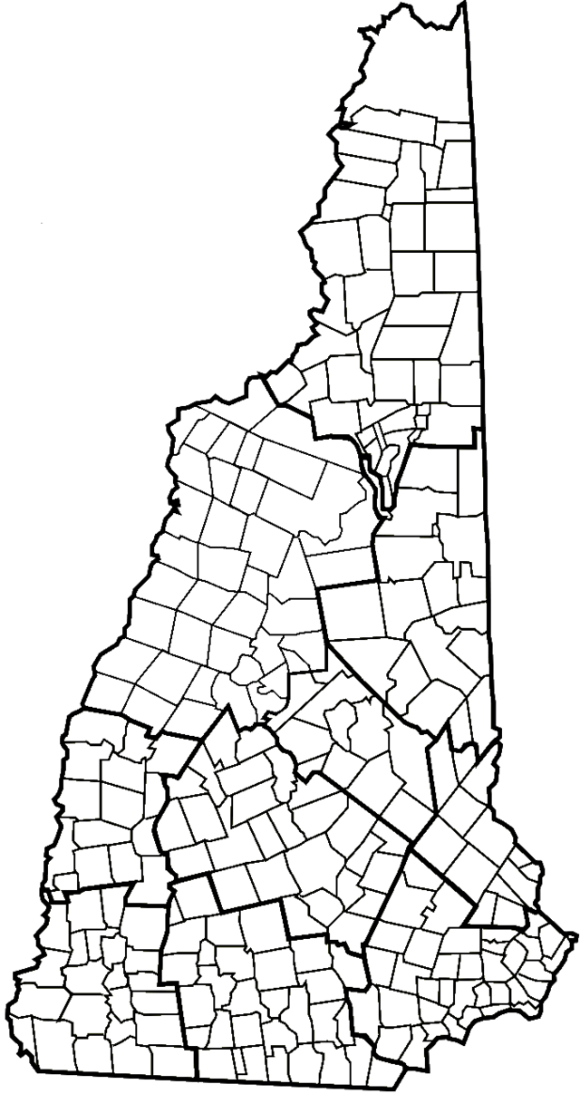
RSA 33-A:3 Municipal Committees
Municipal Officers (or their designee)
Board of Selectmen
City Manager
Mayor
County Commissioners
Precinct Commissioners
Clerk
Treasurer
Assessor
Tax Collector
Notes:
Each municipality shall have one

Slide 11
Municipal Records Retention Committee Function
Establish a retention and destruction policy and procedures by:
Designating the office responsible for the retention of each type of record created
Identifying records within the organization and identifying retention requirements based on ordinance, state and federal laws
Make records accessible as needed
Eliminate unnecessary records (copies are not considered a record)
Create a uniform destruction process
Notes:
Talk about different Policy and Procedures
Derry, Merrimack, Salem, Farmington, Whitefield, Ossippee, Tamworth,

Slide 12
CHAPTER 33-A DISPOSITION OF MUNICIPAL RECORDS SECTION 33-A:3-a
33-A:3-a Disposition and Retention Schedule
The municipal records identified below shall be retained, at a minimum, as follows:
Abatements: 5 years.
Accounts receivable: until audited plus one year.
Aerial photographs: permanently.
Airport inspections-annual: 3 years.
Airport inspections-daily, including fuel storage and vehicles: 6 months.
Annual audit report: 10 years.
ETC……………
Notes:
Visual of the RSA 33-A. Not specific to Tax Collectors
Directly out of Statute.

Slide 13
RSA 33-A:3-a for Tax Collectors
Non-Permanent Record | Retention Period
XXVII. Correspondence by and to municipality – transient | As needed for reference
LIX. Invoices and bills | Audit plus 1 year
LXIV. Leger and journal entry records | Audit plus 1 year
X. Bank Deposit slips and statements | 6 years
XIX. Cash Receipts and disbursement book | 6 years
CXXXV. Tax receipts paid for all warrant types | 6 years

Slide 14
RSA 33-A:3-a for Tax Collectors
Permanent Record – Never Destroy
XXIX | Current Use Release
XLII | Excavation Tax Warrant; book; list
LVIII | Invoice, assessors
LXXVI | Liens – tax sales and record of lien
LXXVII | Liens – tax sales/liens redeemed report
CXXXVI | Tax-deeded property file
CXLIII | Warrants – land use change and book or list
CXLIV | Warrants – property tax and list
CXLVIII | Warrants – utility and betterment tax
CXLIX | Warrants – yield tax and book or list

Slide 15
Electronic Records
RSA 33-A:5-a (Aug 7, 2017)
Paper municipal records listed in the disposition schedule may be transferred to PDF/A format.
If listed on retention schedule to be retained for 10 years or less, records may be retained solely electronically, if so approved by the municipal committee.

Slide 17
QUESTIONS?

