Slide 1
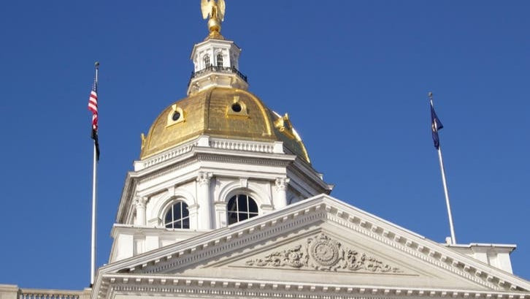
NH TAX COLLECTORS’ ASSOCIATION Education Conference 2023 Demers and Prasol, Inc.
SEPTEMBER 22, 2023

Slide 2
NH General Court – Fun Facts
There are 400 representatives and 24 senators, making the General Court the 2nd largest legislature in the United States following the U.S. Congress.
In the English-speaking world, only the U.S. Congress and British Parliament are larger.
The General Court is called a “Citizen Legislature” because members are not professional politicians but come from a variety of occupations.
For their time and effort they are paid $200 per term (or $100 per year) plus mileage costs.

Slide 3
2023 Session – Bills Tracked
26

Slide 4
2023 Session – Priority Bills
HB51, relative to requiring towns and school districts use warrant articles for lobbying agents.
Inexpedient to Legislate
HB99, requiring tax bills to provide information about a state tax rebate program for lower income homeowners.
Inexpedient to Legislate
SB88, relative to the annual dues paid by towns and cities to town officers' associations.
Conference Committee Report Not Signed Off

Slide 5
2023 Session – Enacted Bills
HB137, relative to boating safety equipment rules and vessel numbering rules, and establishing a committee to study boat registrations fees.
Effective Date: June 30, 2023, with report due by November 30, 2023
HB174, relative to the filing of notice of intent to cut timber.
Effective Date: August 29, 2023
HB197, relative to the proration of property tax exemptions.
Effective Date: April 1, 2024
HB237, relative to the date of asset evaluation for purposes of determining eligibility for certain property tax exemptions.
Effective Date: July 18, 2023
HB595, relative to the oversight of the public deposit investment pool..
Effective Date: July 16, 2023
HB335, relative to notice of tax lien on real estate subject to a lien for old age assistance.
Effective Date: July 18, 2023

Slide 6
2023 Session – Retained/Rereferred
HB314, relative to the expectation of privacy in the collection and use of personal information.
HB433, providing that property tax exemptions granted prior to a home sale shall not be applied to the new homeowner.
HB569, relative to the state education property tax and the low and moderate income homeowners property tax relief program.
SB63, enabling municipalities to adopt a tax credit for qualified private community property owners.
SB191, relative to road toll registration surcharges for electric vehicles.
SB221, establishing a study committee to examine day care access and affordability.
SB255, relative to the expectation of privacy.

Slide 7
2024 Session – Filing Periods
HOUSE
September 11, 2023 First Day to file LSRs
September 15, 2023 Last Day to file LSRs
November 3, 2023 Last Day to sign off LSRs
SENATE
September 28, 2023 First day to file legislation
October 12, 2023 Deadline for the Office of Legislative Services to accept drafting
November 16, 2023 Deadline for prime sponsors to sign off on legislation
November 30, 2023 Deadline for co-sponsors to sign off on legislation
2023 Session
Over 900 bills

Slide 8
Questions
Shaun Thomas
Director, Advocacy & Tax Law
shaun.thomas@demers-prasol.com
603-228-1498

